Slide 1
EdgeIoT: Mobile Edge Computing for the
Internet of Things
Xiang Sun and Nirwan Ansari

Slide 2
About the Authors
Research Interests:
mobile edge computing, big data networking, green edge computing and communications, cloud computing, and the Internet of Things.
Authors:
Xiang Sun is currently an Assistant Professor at the University of New Mexico. He got his PHD from NJIT, and his M.E. and B.E. degrees both from Hebei University. IEEE International Conference on Communications (ICC) Best Paper Award, 2017 IEEE Communications Letters Exemplary Reviewers Award, 2018 NJIT Hashimoto Price, and 2018 InterDigital Innovation Award on IoT
Nirwan Ansari is currently a Distinguished Professor at the New Jersey Institute of Technology. He got his PhD from Purdue and Masters from the University of Michigan. He has been on the board of over 10 journals editorial/advisory boards. He was the Editor-in-Chief of IEEE Wireless Communications for a while.

Slide 3
About the paper
Published in IEEE Communications Journal
Relatively old: 2016
Cited over 600 times and many in the past year (already a few in 2023)
Overviews a design for EdgeIoT
Goes over some of the challenges faced by its implementation

Slide 4
Introduction
Reasons for needing edge computing solution:
High volume and fast velocity IoT needs
Efficient data processing architecture is needed for real time analysis
User privacy exists (?)
Fun claims reel like last time:
https://iot-analytics.com/number-connected-iot-devices/
Value Predicted in 2016 | Actual
50-100 Billion Devices by 2020 | 12.2 Billion (2021)
507.5 ZB/year by 2018 | 900ish EB (1/1000 ZB)

Slide 5
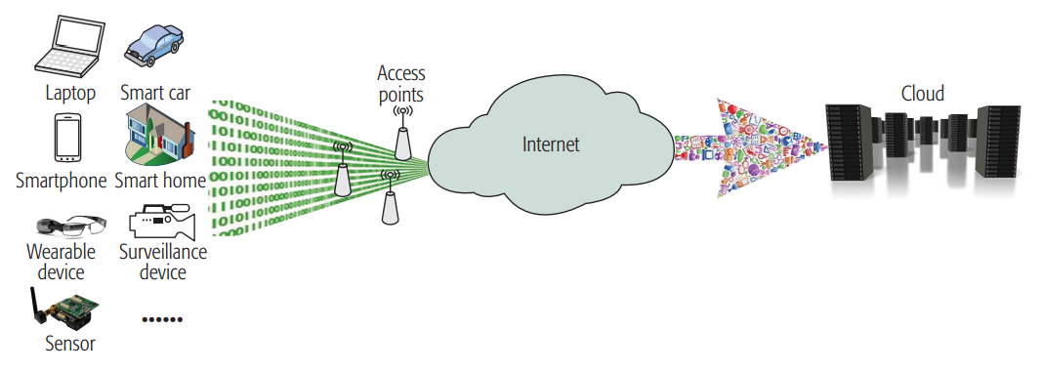
Mobile Edge Computing for IoTs
Fog computing: Distributed computing infrastructure containing a bunch of high-performance physical machines that are well connected with each other.
Optimization for fog node placement isn’t decided yet.
QoS is an issue with different devices having different needs in terms of data size, transmission speed, etc.

Slide 6
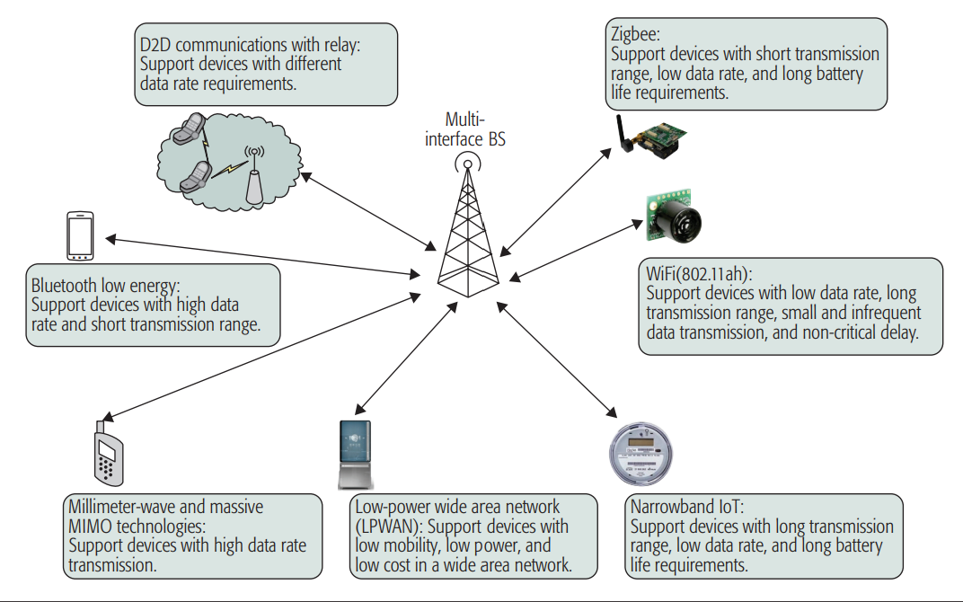
Multi-Interface Base Stations in Cellular Network
Huge numbers of base stations have been deployed for radio frequencies
Use them as multi communication base stations (?)
2 Cents:
Some of these protocols are short range
Most IoT come with receivers already

Slide 7
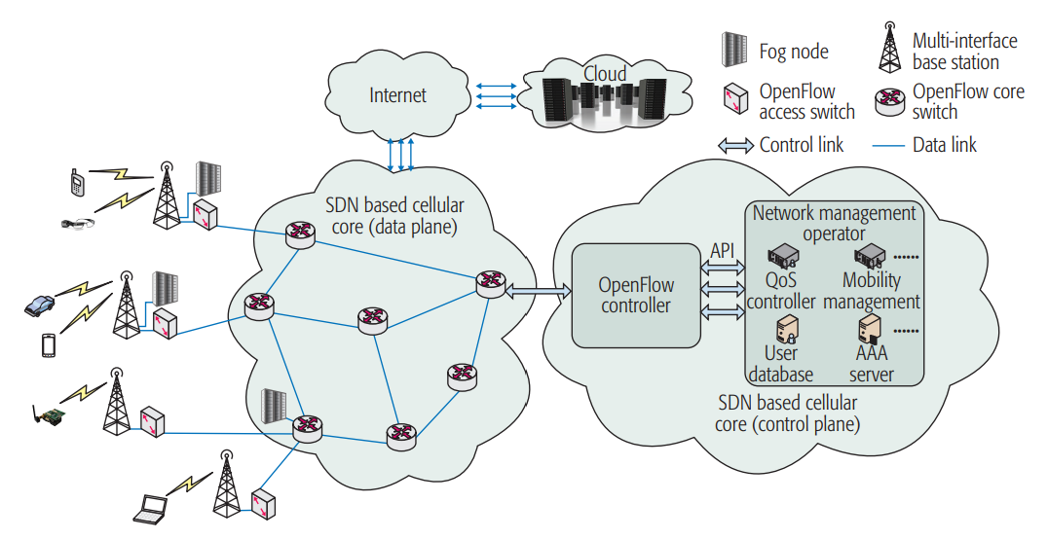
The EdgeIoT Architecture
Goal: Access everywhere with good QoS and computing capabilities with minimal E2E delay
Solution: Use existing Cellular data and control plane
OpenFlow is the SDN for cellular
What about the areas that dont have
good cellular coverage?

Slide 8
Hierarchical Fog Computing Architecture
Benefit to society: Shared data and collaboration of information
Risk: Privacy and personally identifiable information breaches
Solution: Virtual Machines with a hierarchy
User Proxy VMs: Dynamic or static remote VM for a user and their IoT devices. Aggregates all user IoT information and categorizes it before sending it away.
Application VMs: Owned by IoT supplier and controlled by same entity.

Slide 9
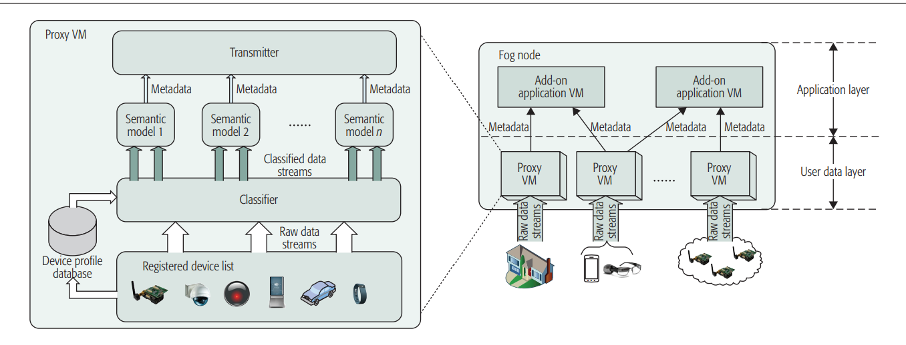
Hierarchical Fog Computing Architecture Cont.
User Proxy VMs can split into 2: a stationary and mobile VM
Only user metadata is sent to application VMs
Potential Issues:
Everything

Slide 10
Hierarchical Fog Computing Architecture Cont.
How long is data held?
How queryable is the data by outside sources/devices?
Who decides what data is transferred to Application VM?
Malicious proxy or application VM can get access to what?
Proxy VMs hold ALL user data for ALL IoT devices: Honeypot
Why aggregate all data based on user and not device, no standard exists?
Can the Proxy split into more than 2?

Slide 11
Application VM Deployment
Local: A fog node made to analyze local proxy VM information
Ex: Local VM analyzing local proxies parking data
Remote: Cloud node analyzing big or aggregated data
Ex: Cloud VM analyzing parking data among a large area to make heatmap
Add-on: time sensitive or “activated” VMs created for a specific task in a specific place Ex: Kidnapping area of interest creates add-on VM to search location more thoroughly

Slide 12
How to Implement EdgeIoT Applications
By downloading an app or somehow “buying into” an IoT service, your proxy VM gets a package from the relative Application VM so it will function.
Reasons for consumer to “buy in”:
Incentive is access to the service provided
Resources gained are the users sensor data

Slide 13
Challenge: Identification of IoT Device and Proxy VM
Each IoT device needs to identify itself to Proxy VM
Each Proxy VM needs to identify itself to the IoT device
IoT device effectively needs an authentication key
My 2 cents:
What happens if a device is sold to a new person? Deregistration process?
If an account is compromised and a new key made, how long does it take to reconnect everything with proper handshake?

Slide 14
Proxy VM Mobility Management
When a user moves, so should a proxy VM
Solution 1: Use existing LTE Mobile management system
Problem: Each device needs an individual SIM card
Solution 2: Phone or mobile device cluster/gateway.
My 2 cents: Battery life, data usage, and device delay effects?
Relies on existing cell coverage.

Slide 15
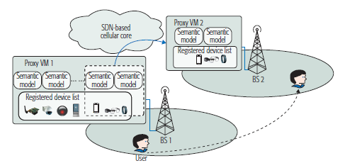

IoT Devices Migration Management
If an IoT moves locations, proxy VMs decompose and migrate to another fog node
Migration to lower E2E delay
Potential for increase traffic with minimal benefit
Equation to calculate “worth” migrations
Humans are predictable so it’s calculatable

Slide 16
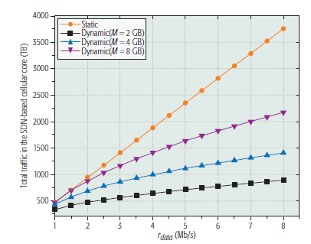
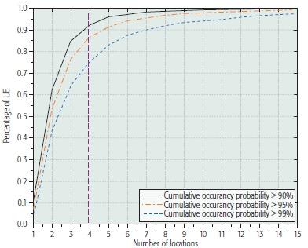
IoT Devices Migration Management Cont.
Is it worth it to migrate?
Dynamic proxies show more efficiency
More memory is not better
Solution:
Most people stay around 4 main BS in a day
Preload VMs at relevant locations

Slide 17
Energy Consumption Consideration
Edge computing may increase costs for ISPs
More energy vs cloud computing
Solution:
Green energy creation onsite to lower energy costs
Send excess energy to other BS

